Slide 1



Development of master curricula for natural disasters risk management in Western Balkan countries
WP2 Development of master curricula - achieved results
Prof. Giuseppe Tito Aronica
University of Messina – Department of Engineering, ITALY
PMC meeting, National Defence School, University of Defence, Belgrade, Serbia
08th March 2018
Project number: 573806-EPP-1-2016-1-RS-EPPKA2-CBHE-JP
"This project has been funded with support from the European Commission. This publication reflects the views only of the author, and the Commission cannot be held responsible for any use which may be made of the information contained therein"

Slide 2
Development of master curricula for natural disasters risk management in Western Balkan countries
WP2 timing
 |  | 2017 |  |  |  | 2018 |  |  |  | 2019
 |  | I | II | III | IV | I | II | III | IV | I | II | III | IV
WP 2 |  | 15/3 |  |  |  |  |  |  |  |  |  | 14/10
Deliverables | 2.1 |  |  | X
 | 2.2 |  |  |  | X
 | 2.3
 | 2.4 |  |  |  |  |  |  |  |  |  |  | X
 | 2.5
X = Report

Slide 3
Development of master curricula for natural disasters risk management in Western Balkan countries
WorkPackage | Indicator | Achieved to date | Output/ Outcomes
2.1 Development of aims, specific competencies and learning outcomes of master curricula in WB HEIs | Defined aims, specific competencies and learning outcomes of master curriculum per HEI in WB; Catalogue of courses | 14 August 2017 | Report
2.2 Development of courses content and syllabi | Defined courses content and syllabi | 14 December 2017 | Service
2.3 Training of teaching staff for innovative teaching methods | Teaching staff trained | 14 December 2017 | Event
2.4 Providing of students' internships positions | Agreements for internships signed | 14 October 2019 | Report
2.5 Harmonization of teaching environment with EU best practices and purchasing of laboratory equipment and literature | Laboratories equipped | 14 June 2017 (postponed because of changing legal status of one WB partner from Bosnia and Herzegovina (VSUP -> UBL). | Service

Slide 4
Development of master curricula for natural disasters risk management in Western Balkan countries
Outputs/ outcomes – LFM code | Comment | Status
2.1 Development of aims, specific competencies and learning outcomes of master curricula in WB HEIs | Catalogue of courses created on time | Delivered in time
2.2 Development of courses content and syllabi | Draft syllabus created | Delivered in time
2.3 Training of teaching staff for innovative teaching methods | OE, MUHEC and TUC organized training in May, June, July, respectively. UNIME prepared training held in Messina in September. Last one was held in Vienna in November 2017. A report for best practice in innovative teaching methods has been delivered | Completed in time
2.4 Providing of students' internships positions | Specific activities to be started | In progress
2.5 Harmonization of teaching environment with EU best practices and purchasing of laboratory equipment and literature | UNI, UNID, KPA, TCASU, UPKM have purchased equipment, software and literature. UBL and UNBS have launched and finished the tendering call | In progress

Slide 5
Development of master curricula for natural disasters risk management in Western Balkan countries

Slide 6
Development of master curricula for natural disasters risk management in Western Balkan countries
Achieved results – Study program implemented
University of Nis (UNI - GAF) - ENGINEERING MANAGEMENT FOR NATURAL DISASTERS RISK
University of Nis (UNI - FZNR) - CATASTROPHIC EVENTS MANAGEMENT
Academy of criminalistics and police studies (KPA) - NATURAL DISASTERS SECURITY RISK MANAGEMENT
University of Pristina settled in Kosovska Mitrovica (UPKM) - NATURAL DISASTER RISK MANAGEMENT
University of Sarajevo (UNSA - CIS) - NATURAL DISASTERS RISK MANAGEMENT
University of Banja Luka (UBL) - NATURAL DISASTERS RISK MANAGEMENT
Technical College of Applied Sciences Urosevac - Leposavic (TCASU) - RISK MANAGEMENT BY CATASTROPHIC EVENTS AND FIRE
University of Defense in Belgrade – Military academy (UNID) - RISK MANAGEMENT IN CASE OF NATURAL CATASTROPHE

Slide 7
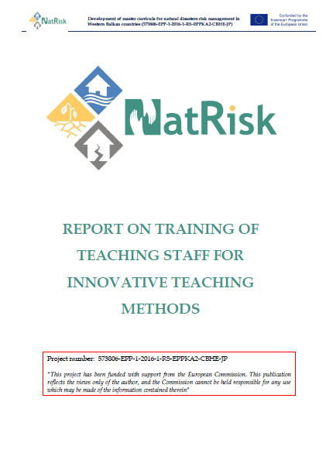
Development of master curricula for natural disasters risk management in Western Balkan countries
Five trainings organised by EU project partners
Obuda University, Budapest, 24-25 May 2017
Middlesex University, London, 29-30 June 2017
Technical University of Crete, Chania, 10-11 July 2017
University of Messina, Messina, 19-20 September 2017
University of Natural Resources and Life Sciences (BOKU), Vienna, 15-16 November 2017

Slide 8
Development of master curricula for natural disasters risk management in Western Balkan countries
Statistics of trained academic staff from the WB HEIs
During the trainings, 87 teaching staff were trained:
UNI – 30
KPA – 9
UPKM – 12
UNSA – 11
UBL – 7
TCASU – 6
UNID - 12

Slide 9

Thank you for your attention
Development of master curricula for natural disasters risk management in Western Balkan countries

